Slide 1
Partition and Quick Sort

Slide 2
Sorting
Input: x₁,…,x_{n}∈X with full order ≤
Output: y₁,…y_{n} such that
{y₁,…,y_{n}}={x₁,…,x_{n}}
y₁≤y₂≤…≤y_{n}
We’ve already seen
Insert sort, with time complexity O(n²)
Heap sort, with time complexity O(n log n)
Q1: what sorting algorithms are good in practice?
Q2: Are there sorting algorithms in o(n log n) time?

Slide 3
Partition - Definition
Input: array A, s.t. A[i]=x_{i} and x∈{x₁,…,x_{n}}
Output: array A and index i s.t.
{A[1],…,A[n]}={x₁,…,x_{n}}
A[j]≤x for all j≤i
x≤A[k] for all i<k
Example

Slide 4
Partition
Partition (A,0,n-1,x) //n≥2
low←0, high←n-1
While (1)
While (A[low]<x) //Loop 1
low←low+1
While (A[high]>x) //Loop 2
high←high-1
If (low<high)
Swap A[low] and A[high]
low←low+1
Else return p←min{high,n-2} //Output

Slide 5
Partition Claims I
Claim: If n ≥2 then 0≤p≤n-2, A[j]≤x for all j≤p and A[k]≥x for all k>p.
Lemma 1: Throughout the execution of Partition, A[i]≤x, for any 0≤i<low, and A[j]≥x for any n-1≥j>high.
Proof (Lemma 1): When the algorithm begins, the statement is vacuously true. Low is increased either in loop 1, in which case A[low]<x, or in the last line of the loop, which occurs after a swap that ensures that A[low]≤x. High is increased in loop 2, in which A[high]>x. Therefore the condition always holds.
Lemma 2: The else clause is reached in finite time, and then either low=high, or low=high+1.
Proof (Lemma 2): In each iteration of the while(1) loop there are three options: either low increases, or high decreases or the else clause is reached. This is the case because either loop 1 is activated increasing low, or loop 2 activated decreasing high, or low is increased in the if clause. Therefore, after at most n iterations of the while(1) loop low≥high. There can’t be an index high<i<low, because by Lemma 1, A[i]<x and A[i]>x. Therefore, at most n+1 iterations of the while(1) loop, both loop 1 and loop 2 stop, the else clause is reached and either low=high or low=high+1.

Slide 6
Partition Claims II
Proof (claim)
When reaching the else clause A[low]≥x and A[high]≤x since both loop1 and loop 2 stop. Consider the values of low and high when reaching the else clause.
If low=0 then low was never increased. But, low≥high, we deduce that loop 2 decreased high and therefore A[i]>x for every 1≤i≤n-1. But, by assumption x is an element of the array, and therefore A[0]=x. In this case, loop 2 stops when high=0. Therefore, the output is p=0 and A[j]≤x for all j≤p and A[k]≥x for all k>p.
If 1≤low≤n-2 then
If A[low]=x then loop 2 stops at high=low. In this case, p=high, and A[j]≤x for all j≤p and A[k]≥x for all k>p because of Lemma 1.
If A[low]>x then loop 2 stops when high=low-1 because of Lemma 2, p=high, and A[j]≤x for all j≤p and A[k]≥x for all k>p.

Slide 7
Partition Claims III
If low≥n-1 then by Lemma 2, either high=low, or high=low-1, but since high≤n-1, there are two options:
High=n-1. In this case, loop 2 did not move high, so A[high]=x. Therefore, low=n-1, since loop 1 would stop at n-1. In this case, p=n-2, and by Lemma 1 and A[j]≤x for all j≤p and A[k]≥x for all k>p.
High=n-2. In this case, by Lemma 1, A[n-1]≥x, and therefore low =n-1, p=high and A[j]≤x for all j≤p and A[k]≥x for all k>p, which completes the proof.
Claim: Partition runs in time O(n) and requires O(1) additional memory.

Slide 8
Partition Claims III
Partition runs in time O(n) and requires O(1) additional memory.

Slide 9
Quick Sort
Quick-Sort (A=[x₀,…,x_{n-1}],low=0, high=n-1)
If low=high
Return
Choose pivot∈{x₁,…,x_{n}}
p←Partition (A,0,n-1,pivot)
Quick-Sort (A,0,p)
Quick-Sort (A,p+1,n-1)
Claim: after running quick-sort, A is sorted

Slide 10
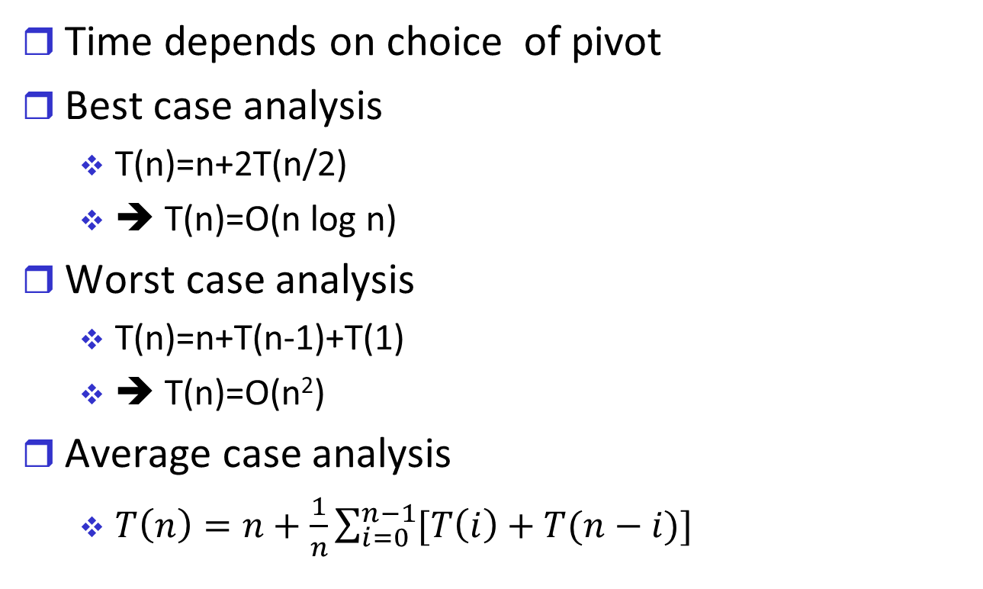
Quick Sort Time I
Time depends on choice of pivot
Best case analysis
T(n)=n+2T(n/2)
➔ T(n)=O(n log n)
Worst case analysis
T(n)=n+T(n-1)+T(1)
➔ T(n)=O(n²)
Average case analysis
$T\left(n\right)=n+\frac{1}{n}\sum_{i=0}^{n−1}{[T\left(i\right)+T(n−i)]}$

Slide 11
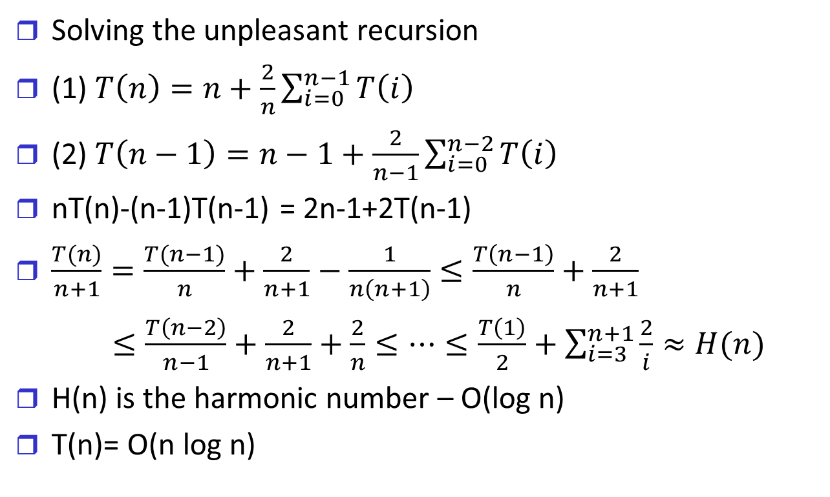
Quick Sort Time II
Solving the unpleasant recursion
(1) $T\left(n\right)=n+\frac{2}{n}\sum_{i=0}^{n−1}{T\left(i\right)}$
(2) $T\left(n−1\right)=n−1+\frac{2}{n−1}\sum_{i=0}^{n−2}{T\left(i\right)}$
nT(n)-(n-1)T(n-1) = 2n-1+2T(n-1)
$\frac{T(n)}{n+1}=\frac{T(n−1)}{n}+\frac{2}{n+1}−\frac{1}{n\left(n+1\right)}≤\frac{T\left(n−1\right)}{n}+\frac{2}{n+1}$
$≤\frac{T\left(n−2\right)}{n−1}+\frac{2}{n+1}+\frac{2}{n}≤…≤\frac{T\left(1\right)}{2}+\sum_{i=3}^{n+1}{\frac{2}{i}≈H(n)}$
H(n) is the harmonic number – O(log n)
T(n)= O(n log n)

Slide 12
Quick Sort Stack
Maximum size of stack - O(n)
How can we limit the stack to O(log n)?
Quick-Sort* (A=[x₀,…,x_{n-1}],low=0, high=n-1)
While (low<high)
Choose pivot∈{x₁,…,x_{n}}
p←Partition (A, pivot,0,n-1)
Quick-Sort (A,0,p)
low←p+1
Else
Quick-Sort (A,p+1,n-1)
high←p

